Slide 1

Accenture
Innovation Challenge
Innovate to create
360° value
Let there be change

Slide 2
Instructions Reference slide– Remove before submission
Use the given template for your idea submission.
Follow file naming format: Team name_Idea Name.pptx
Ensure the spell check is done before submitting
Use standard Arial font, alignment and relevant images (as required)

Slide 3
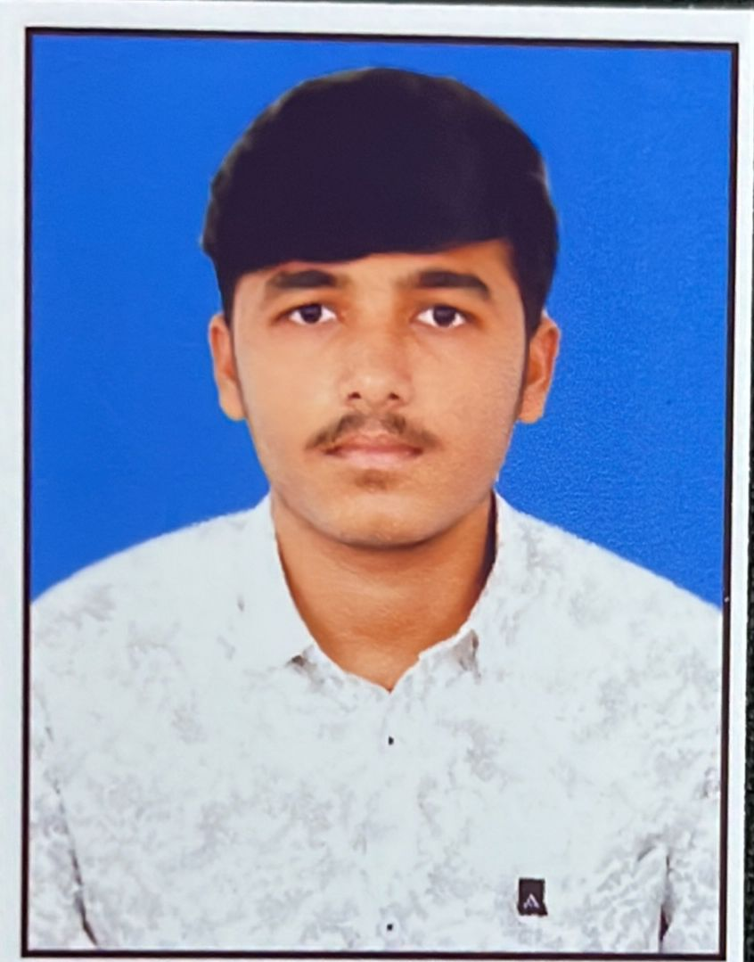

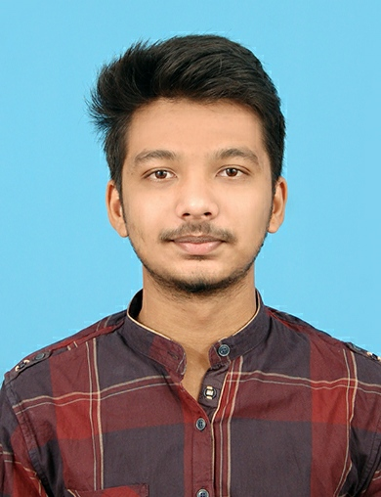
Team details
TEAM NAME: Code chefs
AJAY VISHAL RP
THARUN S
College: Bannari Amman Institute of Technology
Stream: Btech CSBS
Year of graduation: 2025
College:Bannari Amman Institute of Technology
Stream: BE CSE
Year of graduation: 2025
AZHARUDEEN S
Photo
College:Bannari Amman Institute of Technology
Stream: Btech AI & DS
Year of graduation: 2025
All fields are mandatory

Slide 4

Theme
Please highlight one from the below:(Choose one and highlight it)
Innovate For Business
Develop innovative business solutions, offering or a business model that disrupts the competition in the given industry space
Innovate for Business
Innovate for Society
Innovate For Society
Apply technology in innovative ways to help improve the way we work and live, and create value for our society
Innovate for a Sustainable World
Innovate for a Sustainable World
Develop innovative business to tackle some of the world’s greatest ‘environmental challenges’

Slide 5
Describe the problem statement (200 words)
Our Idea is about to prevent the theft happening in the temples like ornament theft, money bank theft and more. Establishment of cctv camera is a good idea but we can see only after the theft got happened. To tackle this theft we got an idea to keep a sensor near the ornamental room and the money bank when any one goes near to it which alarms and sends an aleart message to the person who is responsible for that temple. We can set a speaker on the hidden place of the temple to alert the surrounding near the temple. By this we can tackle the theft.

Slide 6
Proposed solution / your big Idea (200 words)
We planned to Keep a normal human detection Arduino sensor near or on the money bank an jewellery room . When something detected through the sensor immediately the speaker which is connected to the sensor started to alarm. Using IOT we can send the sms or aleart message when the sensor is getting detected.
Describe TECHNOLOGY USED : Example - Natural Language Processing, Machine Learning, any other…

Slide 7
How does your innovation create 360° value? (200 words)
By our idea we can able to stop the theft before it is getting over. No more jewellery theft or money bank theft is gonna be happened .
Learn more about how we deliver 360° value
https://www.accenture.com/in-en

Slide 8
How is your solution different/unique from other solutions in market (150 words)
Till now in temples and pilgrim places cctv cameras are used by this we can see but we cannot stop. We are the first team to make this idea to be happened. We are using Human detection Arduino sensor , speaker and IOT algorithms for alert message
PATENT FILED: No
Do you have a working model/prototype: No
If not, will you be able to show working prototype during finale. Yes

Slide 9
Any testimonials received? : No
Share the links/photos of the testimonials you’ve received

Slide 10
Elevator pitch video (1 minute) Share the public link

Slide 11
Thank you!

